Slide 1


Department of
Electronics & Communication Engineering
(Estd. 2001)
Accredited by NAAC with ‘A’ Grade, Accredited by NBA – TIER I

Slide 2
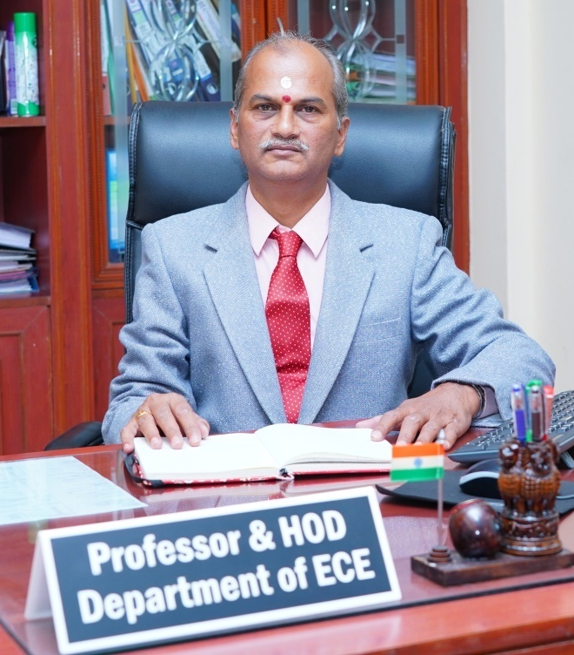
HoD’s Profile
Profound experience of more than 37 years in the field of Electronics & Communication Engineering.
Served for more than 17 years in Telecom industries, being involved in the design and development of communication products.
His research profile has acclaimed an h-index of ‘10’ with more than 310 citations.
He has published more than 65 technical articles in SCOPUS as well as WoS indexed journals as well as conferences.
He has authored a book, edited a book (CRC Press, Taylor & Francis), and has published a book chapter, and one Souvenir article.
Reviewer for many reputed international journals such as JOFI, IJCTA, CSSP, IET-CDS, JBMT, IJCDS and Automatika.
He was honored with “Long Service Award” in 2018 at New Horizon College of Engineering, in appreciation for his passion, dedication and contribution.
He is an active member of IEEE and has shared his teaching-learning resources in Scribd, Slideshare, Academia etc.
Dr. Aravinda K.
B.E., M.S.(Engg), M.Tech, Ph.D., SMIEEE

Slide 3
PROGRAMS OFFERED
B.E – Electronics & Communication Engineering
Offered in 3 variant Streams
Regular
Minor degree
Honors degree

Slide 4
ECE - COURSE STRUCTURE
Semester I (Chemistry cycle)
Applied Mathematics for Engineers - I
Applied Chemistry for Engineers
Applied Chemistry Lab for Engineers
Introduction to Electrical Engineering
Elements of Electronics and Communication Engineering
Elements of Electronics and Communication Engineering Lab
Computer Aided Engineering Drawing
AI-Powered Communicative English
Constitution of India and Professional Ethics
Environment and Disaster Management
Semester II (Physics cycle)
Applied Mathematics for Engineers - II
Applied Physics for Engineers
Applied Physics for Engineers Lab
Introduction to Mechanical Engineering
Programming in C
Programming in C Lab
Introduction to AI and Applications
UHV and Indian Ethos
Professional writing skills in English
Samskrithika Kannada / Balake Kannada
Inter-Disciplinary Project Based Learning

Slide 5
COURSE STRUCTURE (NEP - 160 credits)
Semester III
Numerical Methods and Transforms
Analog Electronic Circuits
Analog Electronic Circuits Lab
Digital Electronic Circuits
Digital Electronic Circuits Lab
Signals and Systems
Circuit Design and Analysis
Ability Enhancement Course - III
Design Thinking and Fabrication
Non-credit Mandatory Course (NSS/PEd/Yoga)
Semester IV
Numerical, Complex Analysis and Probability Theory
System Design using HDL
System Design using HDL Lab
Digital Signal Processing
Digital Signal Processing Lab
Microprocessors & Microcontrollers
Microprocessors & Microcontrollers Lab
Professional Elective Course - I
Ability Enhancement Course - IV
Universal Human Values & Life Skills
Mini Project
Non-credit Mandatory Course (NSS/PEd/Yoga)

Slide 6
COURSE STRUCTURE (NEP - 160 credits)
Semester V
Operations Research and Management
Communication Systems - I
Communication Systems - I Lab
CMOS VLSI Design
CMOS VLSI Design Lab
Professional Elective Course - I
Research Methodology and IPR
Critical and Creative Thinking Skills
Environmental Studies
Mini project - II
Non-credit Mandatory Course (NSS/PEd/Yoga)
Semester VI
Embedded System Design
Embedded System Design Lab
Communication Systems - II
Communication Systems - II Lab
Essentials of Cyber Security
Professional Elective Course - II
Project Phase - I
Problem Solving Skills
Ability Enhancement Course - V
Industrial Open Elective - I
Non-credit Mandatory Course (NSS/PEd/Yoga)

Slide 7
COURSE STRUCTURE (NEP - 160 credits)
Semester VII
Wireless Communication
Wireless Communication Lab
Computer Vision
Computer Vision Lab
Coding and Cryptography
Project Phase - II
Scientific Foundations of Health
Industrial Open Elective - II
Semester VIII
Professional Elective Course - III
Professional Elective Course - IV
Internship
Indian Knowledge Systems

Slide 8
LIST OF INDUSTRIAL OPEN ELECTIVES
Data Analytics using R Programming
Robotic Process Automation
SAP
Product Life Cycle Management
Industry 4.0
Schneider - Industrial Automation
CISCO - Routing and Switching-1
CISCO - Routing and Switching-2
5G Mobile Communication
VLSI Physical Design-1
VLSI Physical Design-2
Juniper Network Operating System
Advanced Networking
QNX - Embedded Programming

Slide 9



ECE - CENTRES OF EXCELLENCE
Project ideas and Student mentoring by Industry experts
Internship opportunities with guidance to Students
Industrial training to Faculties and Students
Core engineering Placement offers
Contribution in Curriculum Development
Interaction with Industry experts on courses offered
Guest lectures and Workshops presented by Industry experts
Exposure to real Industry Environment

Slide 10
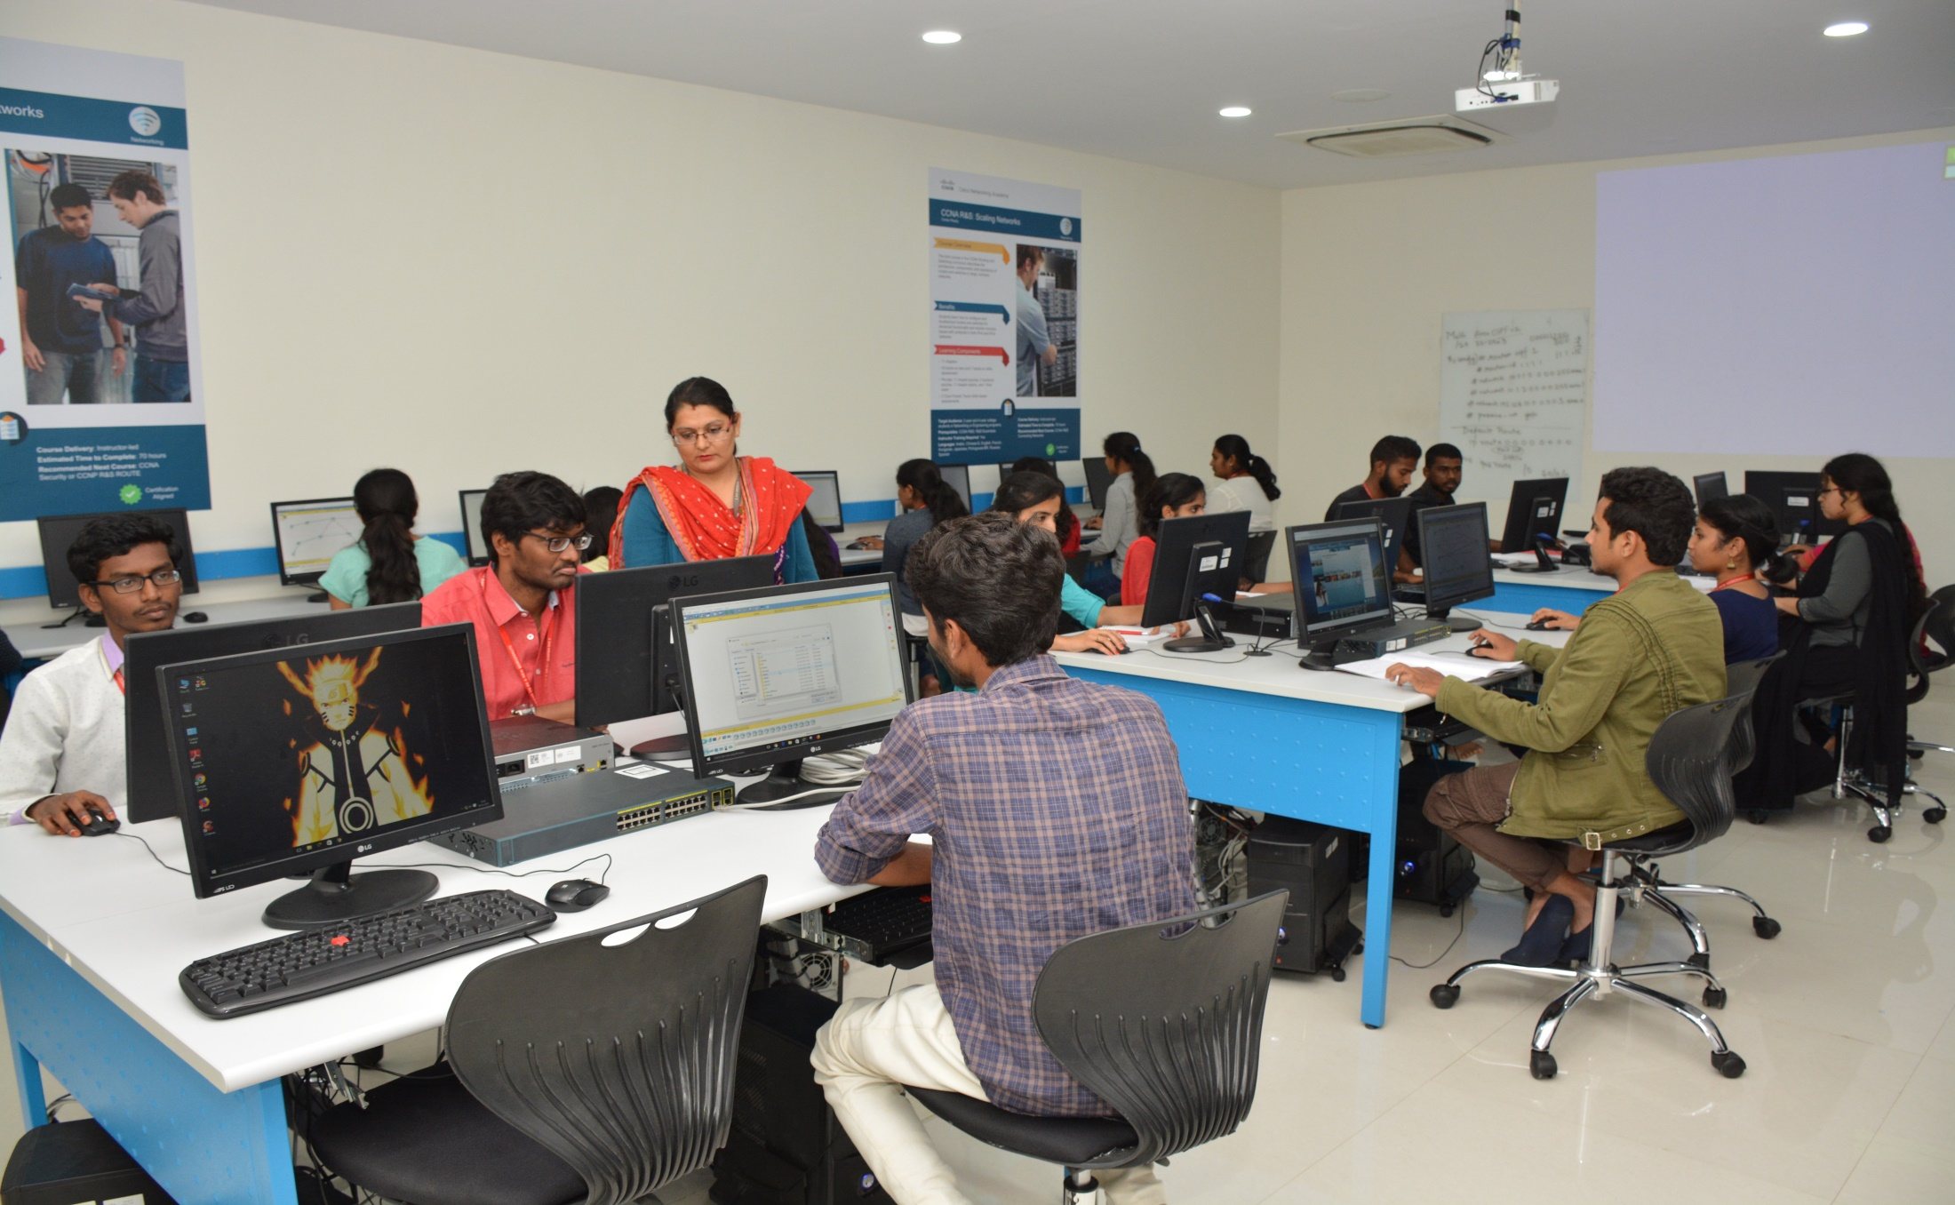
CISCO – CENTRE OF EXCELLENCE

Slide 11
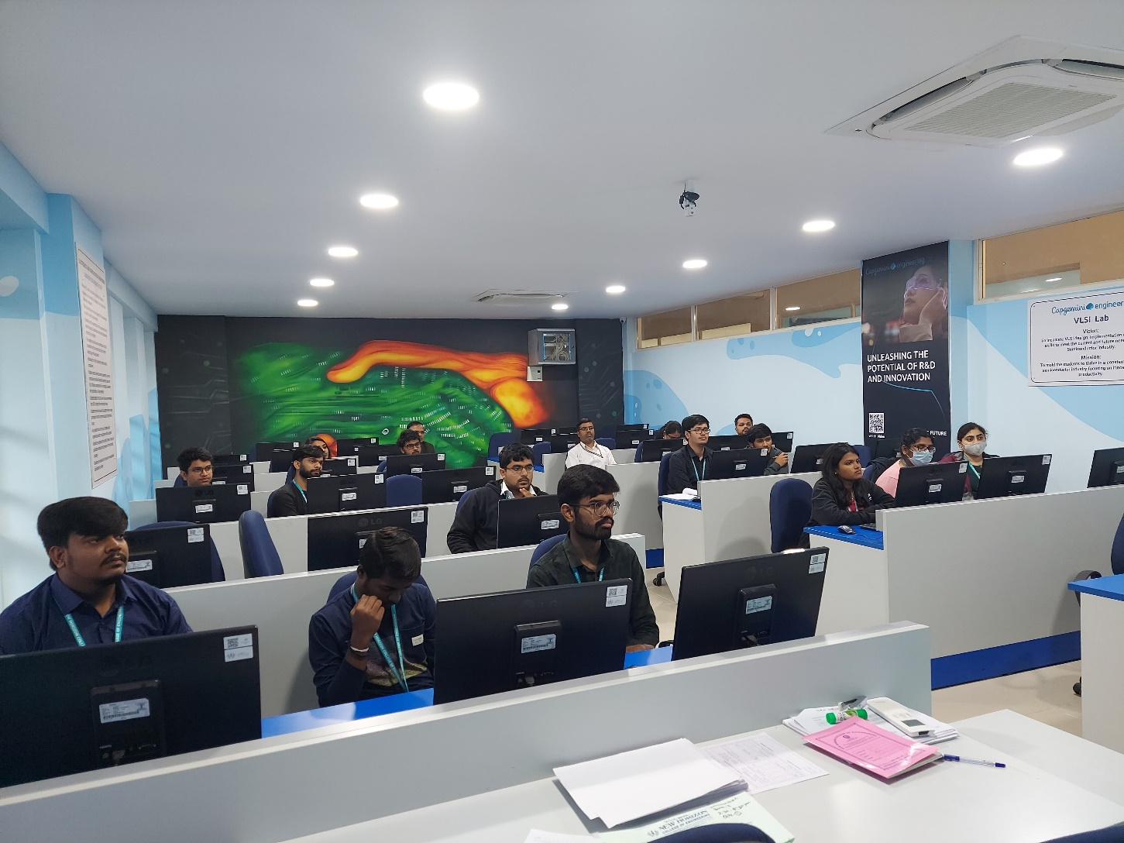
CAPGEMINI – VLSI CENTRE OF EXCELLENCE

Slide 12
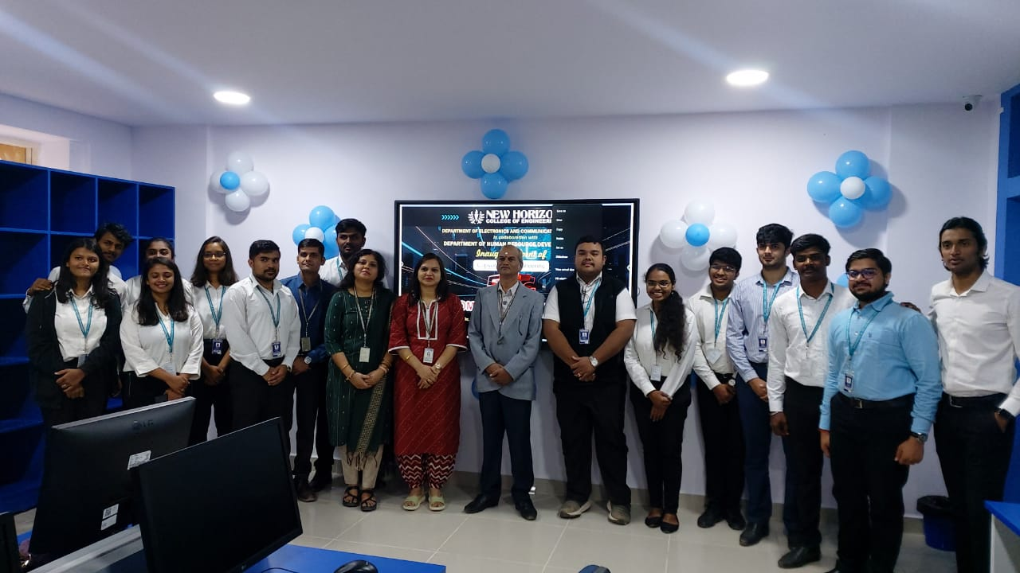
CAPGEMINI – 5G CENTRE OF EXCELLENCE

Slide 13
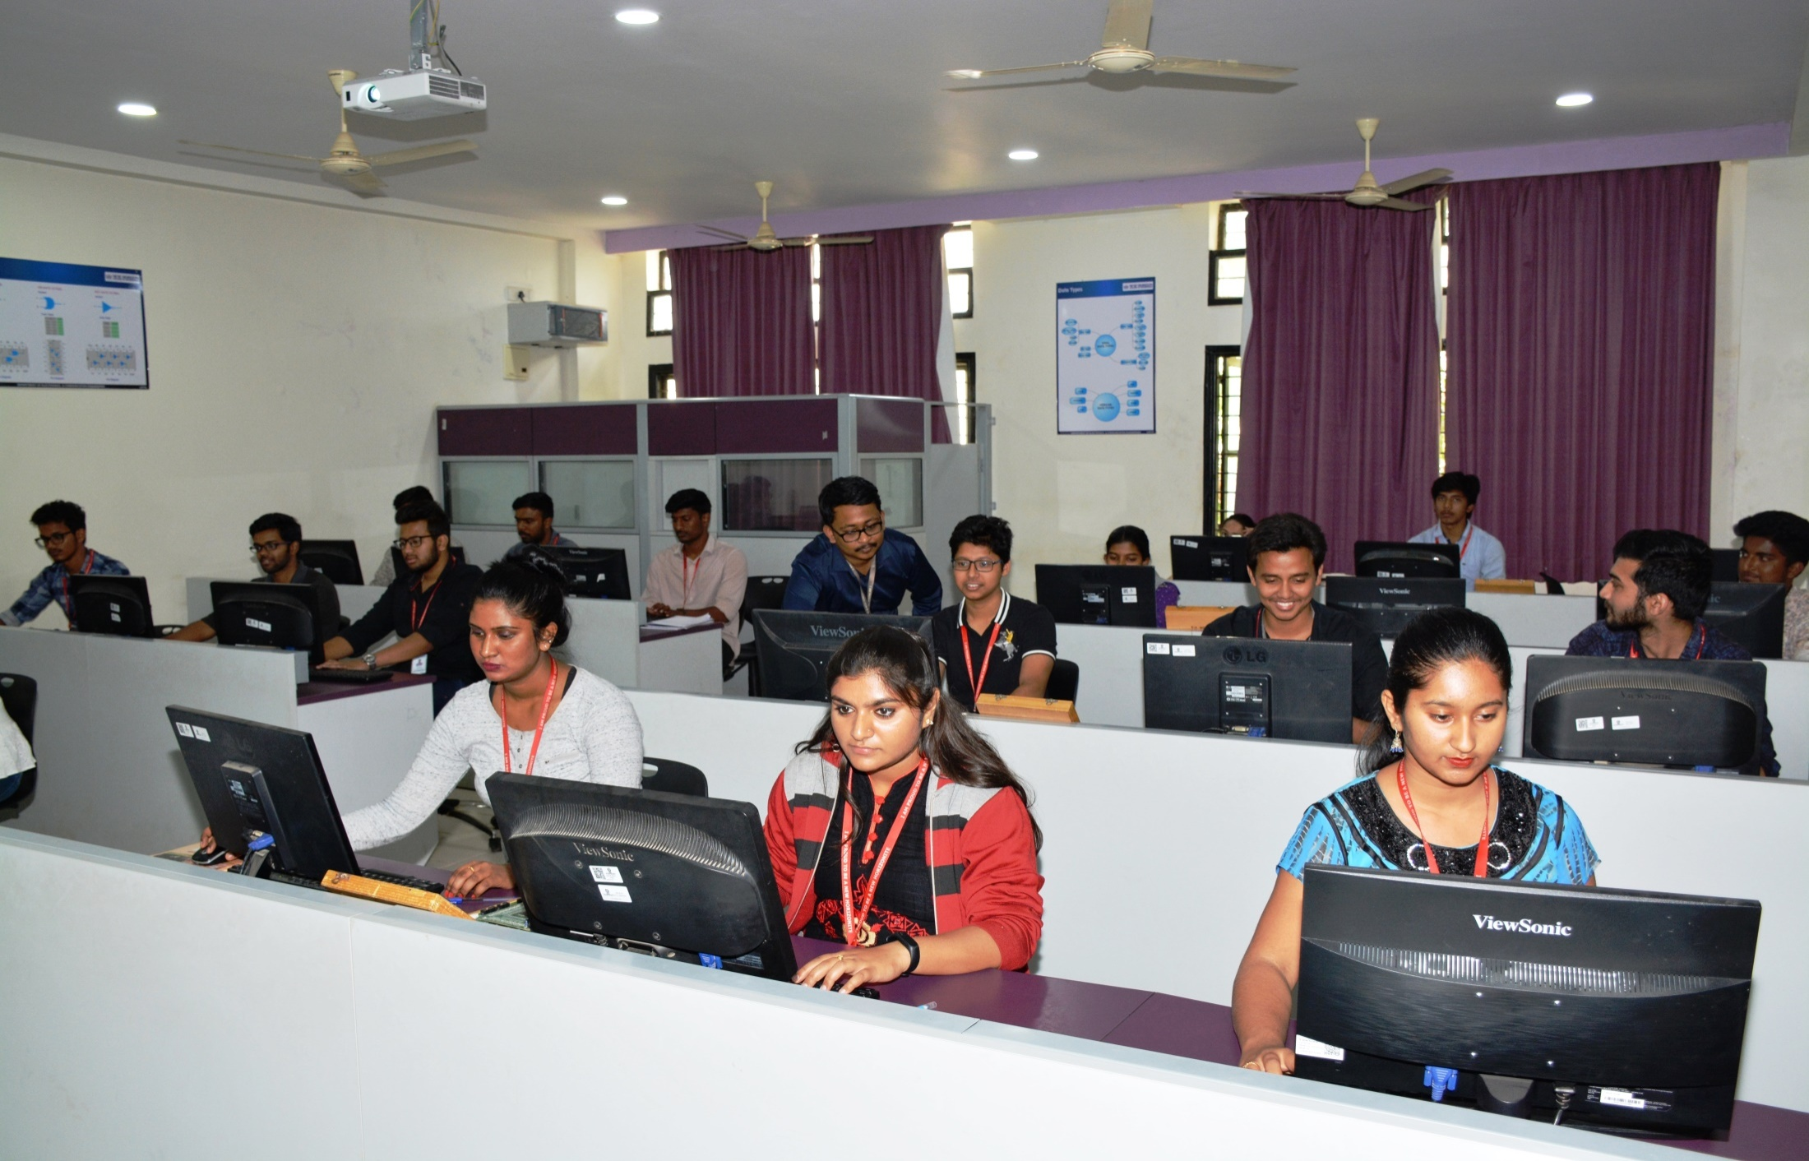
DEPARTMENT OF ECE : HDL LAB

Slide 14
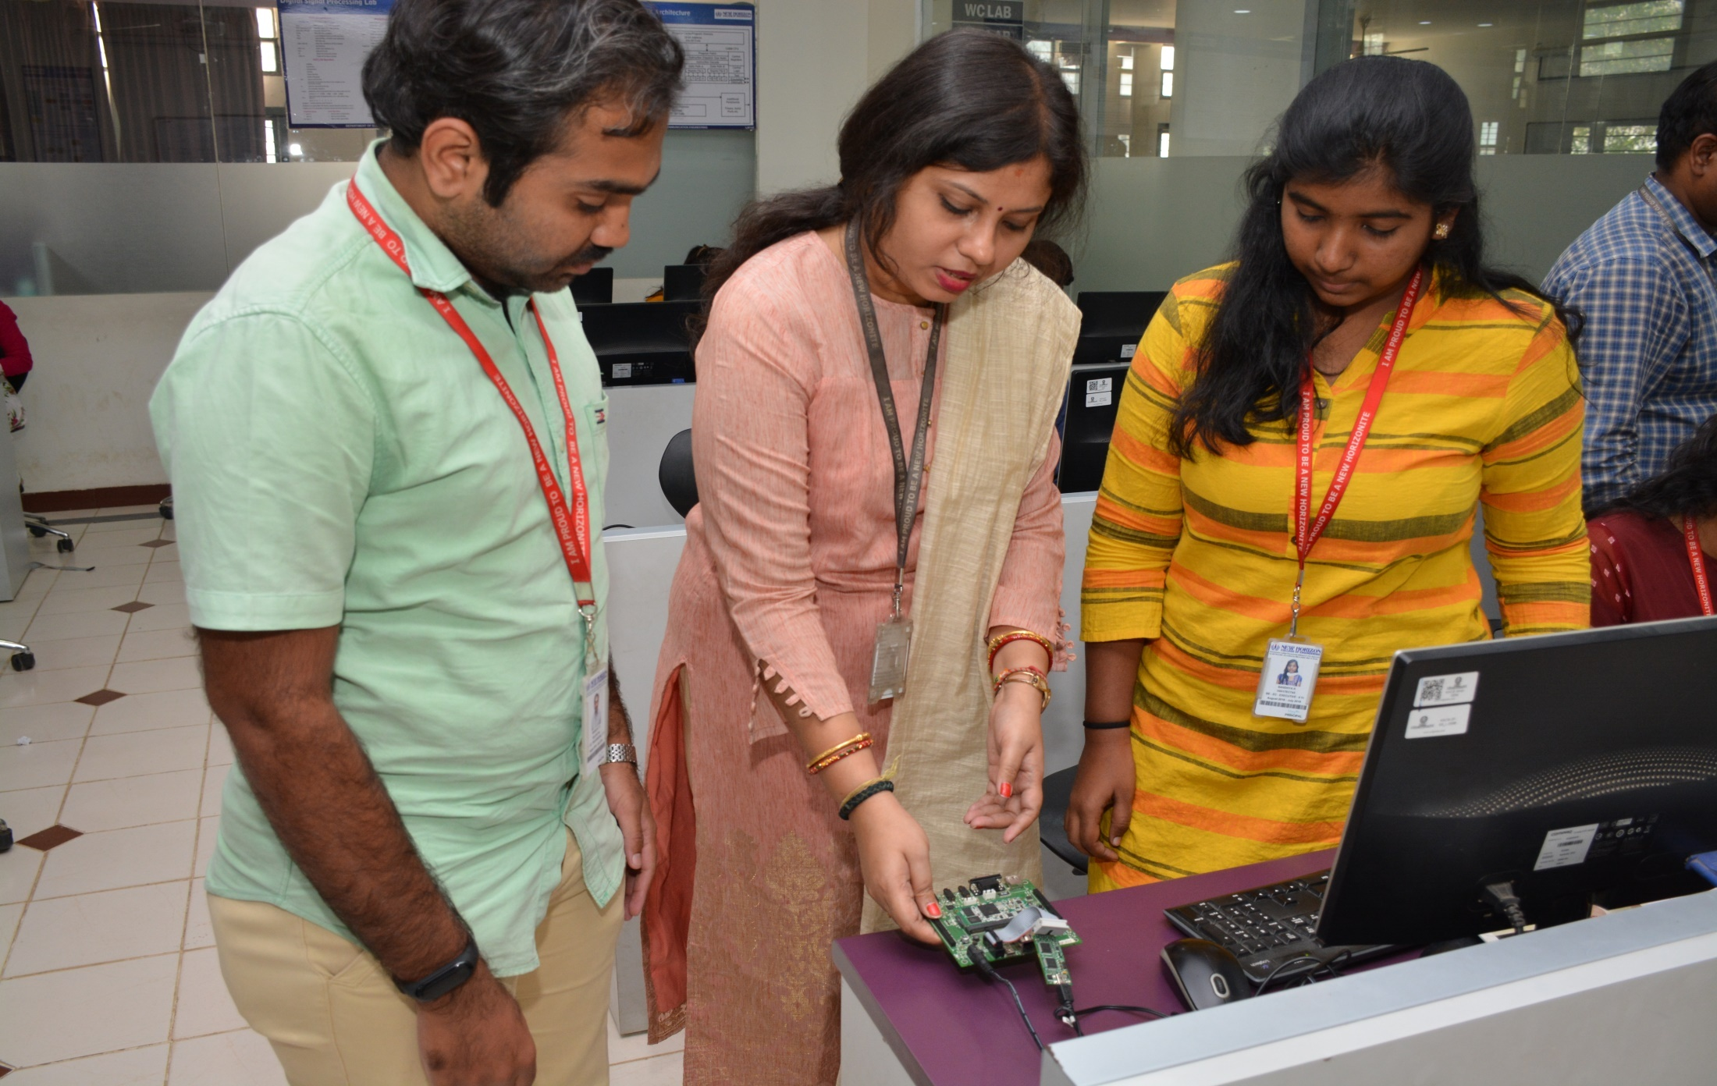
DEPARTMENT OF ECE : DSP LAB

Slide 15
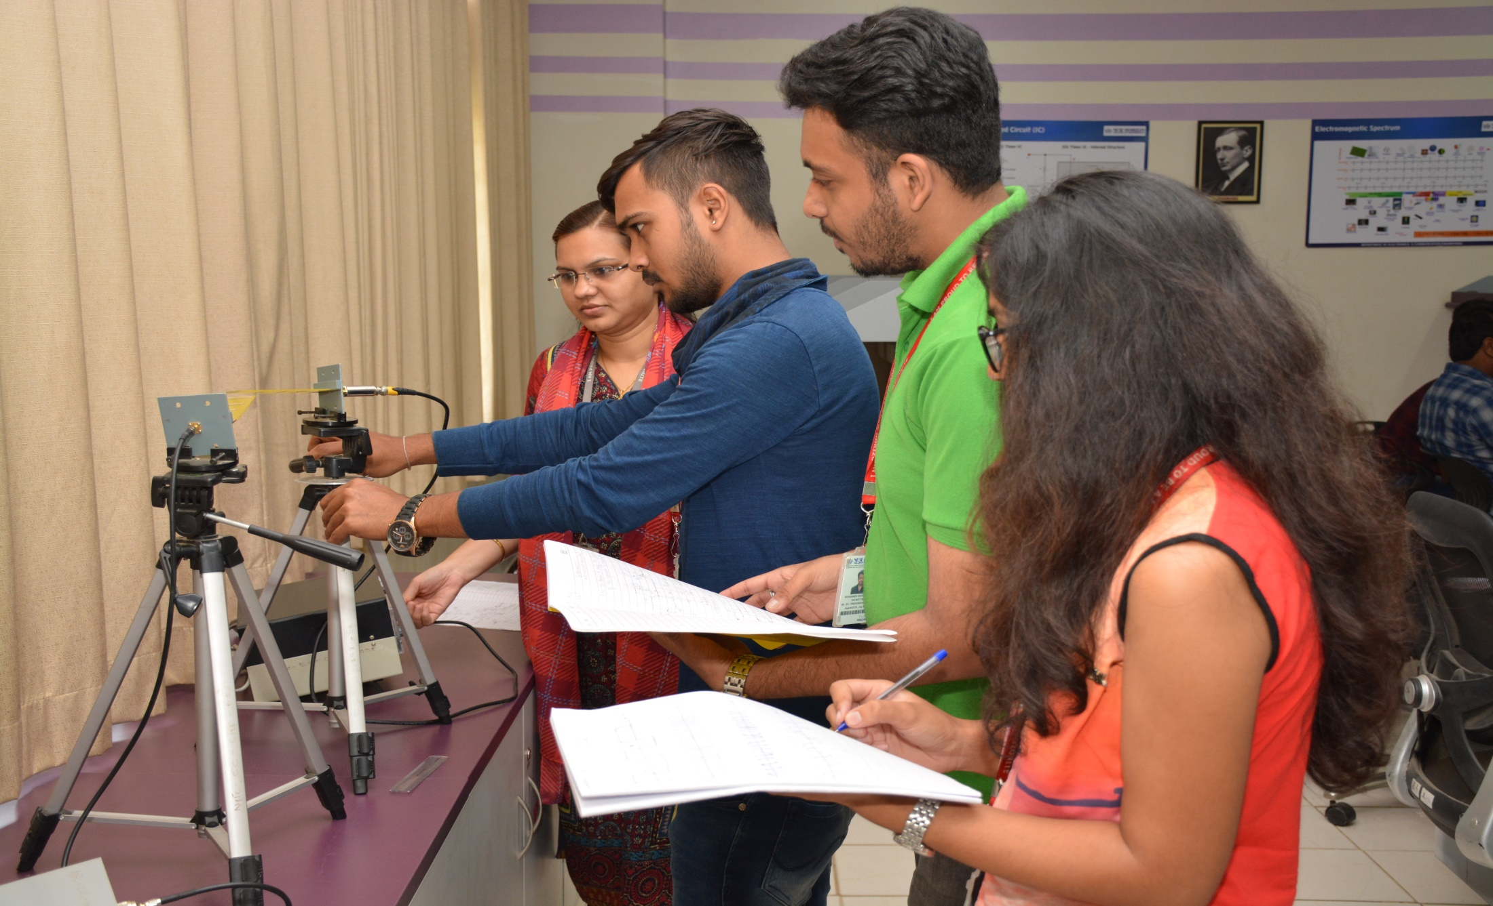
DEPARTMENT OF ECE : COMMUNICATION LAB

Slide 16
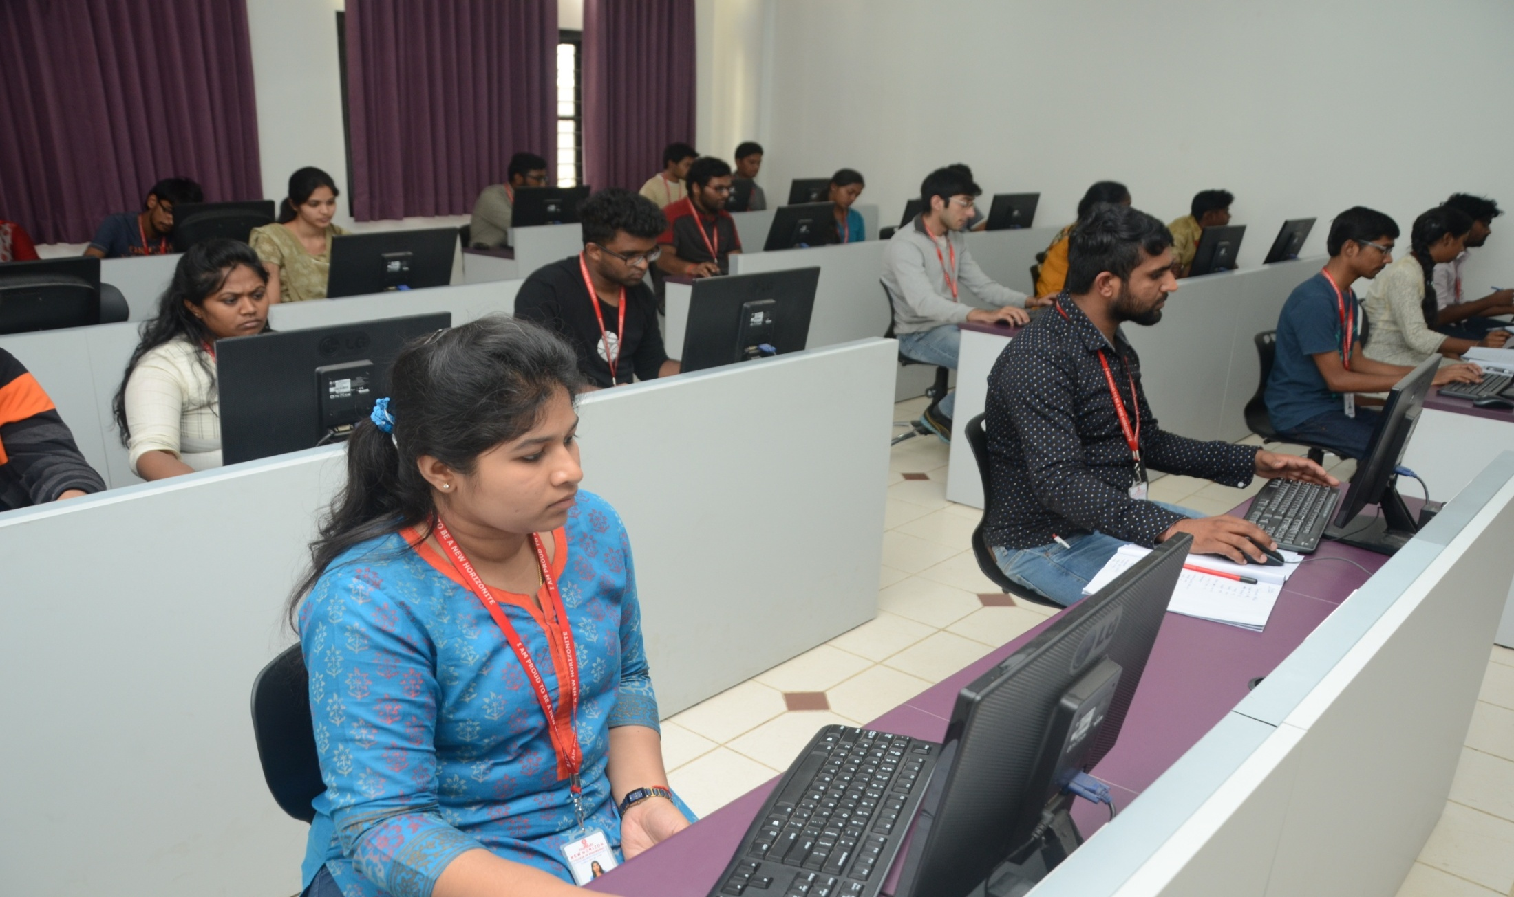
DEPARTMENT OF ECE : EMBEDDED SYSTEM DESIGN LAB

Slide 17
STRENGTHS OF THE DEPARTMENT
Well qualified Professors having many sponsored Projects, Research grants, SCI/SCOPUS Publications and Patents
Eight state-of-the-art Labs
SMART Boards in all the Class rooms and Laboratories
Project / Internship based learning
Highly matured Administrative environment

Slide 18


STUDENT CLUB ACTIVITIES
Aerobots Club: To establish a dynamic and cutting-edge platform that fosters student curiosity and expertise in the fields of Unmanned Aerial Vehicle (UAV) & Aviation technology,
EMSYS NEX GEN: To cultivate a vibrant student community of people passionate about exploring the world of embedded systems and IOT.

Slide 19





PROFESSIONAL MEMBERSHIP
IEEE – Students Chapter
MTS –Marine Technology Society
IETE - The Institution of Electronics and Telecommunication Engineers
ISTE - The Indian Society for Technical Education (ISTE)
IEI - The Institution of Engineers (India)

Slide 20
STUDENT MENTORING & OTHER KEY DIFFERENTIATORS
Each student is assigned to a Faculty mentor
Mentoring details are entered in Contineo software
Parents are updated with SMS about the absenteeism
Progress is individually monitored
Certified Professional Counseling

Slide 21
PLACEMENT THROUGH VALUE-ADDED TRAINING
Aptitude training practice by highly qualified Industry Experts
Soft Skills training
Employability index Mapping Workshop
Training on facing the Interview
Training on Group discussion
Exclusive CV writing workshop
Comprehensive Technical training
Behavioral training and Personality development programs

Slide 22
Capgemini
ShopDeck
KPIT
SAP Labs India
Computacenter
ITC Infotech
Yuvipep
L&T Technology Services
Cinepebble
Ernst & Young
Infosys
Accenture
Visa
Siemens
Epsilon
Spektra Systems
IBM India
HealthAsyst Oneadvanced
Bulk Liquid Solutions
MAJOR IN-CAMPUS
RECRUITING COMPANIES
Nokia
Epicor Software
UNISYS
Newjaisa
Zepto Yokogawa
LTI Mindtree
Sopra Steria
Intellipaat
Temenos
Microland
Eurofins IT Solutions
TCS
Visteon
DXC Technology
Micronel Global Engineers
Fractal.ai
Oracle
FINTELLIX
Cubic Logics
Wimera
Mathco
SolarEdge Technologies

Slide 23





















Slide 24




















Slide 25
CO-CURRICULAR ACTIVITIES
Industry Expert lecture to bridge the gap between industry and Academia
Symposiums and paper presentations
Seminars and Guest Lectures by eminent Academicians
More than 4-Industrial visits in each Semester
In-Plant training/Internships in the industrial sectors
Workshops/Projects on latest technologies
Inter collegiate technical fest – Quantum X

Slide 26
EXTRA-CURRICULAR ACTIVITIES
Sports activities (Indoor, Outdoor)
Cultural activities through student clubs
Inter collegiate national level cultural fest - SARGAM

Slide 27
INDUSTRY - INSTITUTE INTERACTION
Campus connect – parents, employers
Regular visits by Industry experts
Certificate course in Embedded System Design and in VLSI Design
Certificate course in Management and Leadership

Slide 28
ALUMNI
Alumni Meet
Alumni talk to students
Alumni interaction with students
Alumni involvement in Board of Studies
Alumni involvement in student placements

Slide 29
RESULTS
Above 90% results in B.E course

Slide 30



THANK YOU
For more information please contact
Phone: 080-66297777
E mail: admissionsnhce@newhorizonindia.edu
Website: www.newhorizonindia.edu
Follow us on:

